Slide 1
CSE 1801
Object Oriented Programming
Introduction

Slide 2
Acknowledgement
For preparing the slides I took materials from the following sources
  Course Slides of Dr. Tagrul Dayar, Bilkent University
  Java book “Java Software Solutions” by Lewis & Loftus.

Slide 3
Outline
Course Objectives
Text Book
Objects
Classes
Abstractions
Encapsulations

Slide 4
Course Objectives
Learning object-oriented programming with Java.
Writing and enhancing
  Classes
  Arrays
  Inheritance and polymorphism
  Abstract classes and interfaces
  Graphical user interface
  I/O streams
  Exceptions.

Slide 5
Text Book
Lewis & Loftus, “Java Software Solutions – Foundations of program design”, Addison Wesly, 8th edition, 2014.
Deitel & Deitel, “ Java: How to program”

Slide 6
Java is an Object-Oriented Language
In structured programming languages, methods define the structure of the programs, they are basic building blocks
Data has secondary role, it is just something that is passed around.
In object oriented languages, the data has the principal role
Methods belong to the data, without the data, the method does not have any meaning (Except static methods)
Data and methods together make up the object.
OOP tries to model the real world.
What does the real world look like?

Slide 7







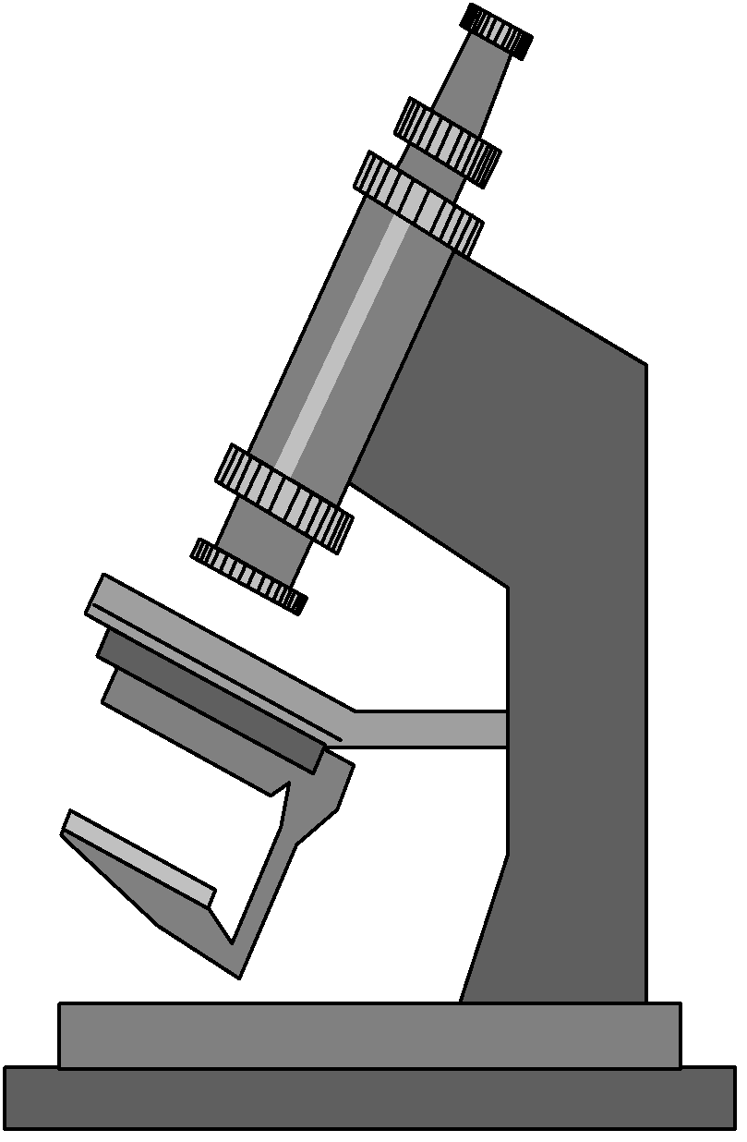

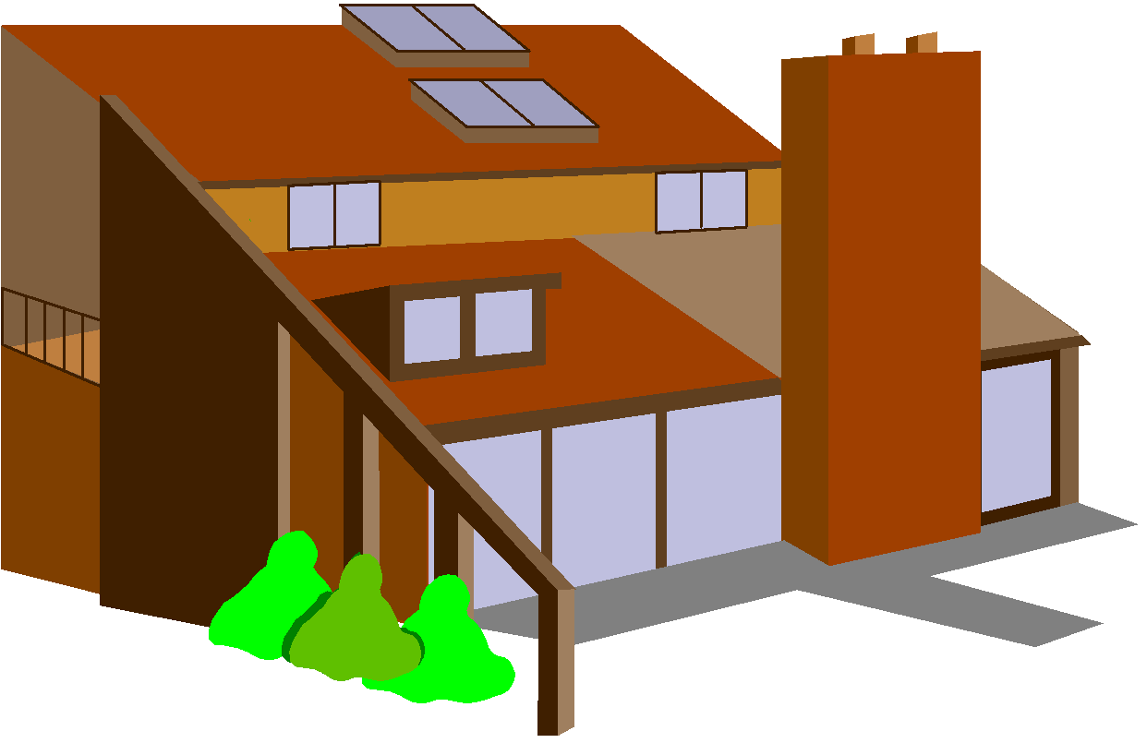
Objects everywhere...
Real world entities

Slide 8






Objects have state...
Lying
Red
Hooked
Broken
Happy
ill

Slide 9




Objects have behavior….
Hello,I am Tomal
da da …
Nice to
meet you
Grrrrrrrr
Vroemm

Slide 10
World
The world is
  a set of things
  interacting with each other.
OOP is more natural to humans, but less natural to computers
Computers (usually) have a single thread of control, so objects take turns

Slide 11
Describing the world
Describe a particular person
  Mohima has long blond hair, green eyes, is 1.63m tall, weighs 46Kg and studies computer engineering. Now sitting in the class room.
  Kherwar has short black hair and brown eyes. He is 180cm and 55 kilos. Now thinking to take a nap!
Notice how all have specific values of
  name, height, weight, eye colour, state, …
Notes:
Describe some particular books; your textbooks for example.
What features (properties & functionality) characterise a book?
How about cars?

Slide 12

Object Properties
Identity
State
Behavior
on
off
myLamp
Object is an abstraction of a real world entity

Slide 13
Introduction to Objects
An object represents something with which we can interact in a program
An object provides a collection of services that we can tell it to perform for us
The services are defined by methods in a class that defines the object
A class represents a concept, and an object represents the embodiment of a class
A class can be used to create multiple objects

Slide 14
Objects and Classes
A class
(the concept)
An object
(the realization)
Bank Account
Siam’s Bank Account
Balance: $5,257
Rifat’s Bank Account
Balance: $1,245,069
Multiple objects
from the same class
Gyan Prokash’s Bank Account
Balance: $16,833

Slide 15
Java OOP terminology
Class - Category
  Properties/states
  Functionality/Services
  (examines/alters state)
data
methods
object - Individual/unique thing
(an instance of a class)
  Particular value for each property/state
  & functionality of all members of class.
Notes:
Class acts as blueprint for creating new objects
Properties/states correspond to memory locations having particular values
Functionality corresponds to the methods that examine/manipulate the property values

Slide 16
Java OOP Software
Software System
  Set of objects
  Which interact with each other
Created (instantiated) from class definitions
One object will send a message to another object asking it to do a particular task. The first object does not need to know how the task is done (only how to request that it be done.)
This corresponds to calling one of the
second object’s methods!
Person
Riti
Summa
Riti: Say your name
“Summa”
Notes:
Set of objects are created in a main method (which is thus is like the world.)
One or more objects are then “sent messages” asking them to do something (i.e. their methods are called.)
They in turn, may create and/or send messages to other objects in other to achieve their task.
Ayse: David – go to sleep, run to class (david changes state)
Or
Ayse asks florist to send flowers to mother in Istanbul. Florist asks Ayse for x dollars. Ayse offers credit card to florist. Florist asks bank to ok it which they do. Florist now asks another florist in Istanbul to deliver flowers to specified address. That florist asks delivery boy to take them. He finds house etc. Ayse has no idea about all this. The Ankara florist doesn’t know or care how flowers get delivered to house either!
Objects need not be “real”. May have a date object, or a random number generator, or a string tokenizer, or webpage generator, or an error message, or …
Sounds natural to ask person to do something for you, but in OOP you ask all sorts of objects to do things for you.
eg. Ask a book to turn its page, ask a wallet to give you some money, a random number object to give you a random number, …

Slide 17
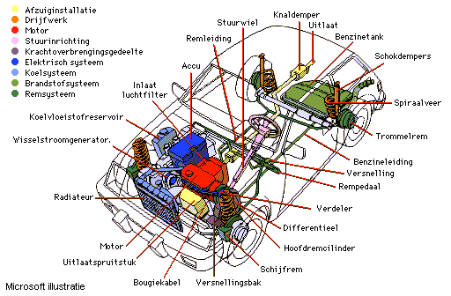
Abstraction
An abstraction hides (or ignores) unnecessary details
denotes the essential properties of an object
One of the fundamental ways in which we handle complexity
Objects are abstractions of real world entities
Programming goal: choose the right abstractions
Abstraction
A car consists of four wheels
an engine, accumulator
and brakes.

Slide 18
Multiple Abstractions
A single thing can have multiple abstractions
Example: a protein is…
a sequence of amino acids
a complicated 3D shape (a fold)

Slide 19
Choosing Abstractions
Abstractions can be about
tangible things (a vehicle, a car, a map) or
intangible things (a meeting, a route, a schedule)
An example:
Abstraction name: light
Light’s wattage (i.e.,energy usage)
Light can be on or off
There are other possible properties (shape, color, socket size, etc.), but we have decided those are less essential
The essential properties are determined by the problem

Slide 20
Object-Oriented Model
methods
Object boundary
data

Slide 21

Example: Pencil
home
up
down
write
location
direction
penDown

Slide 22
Encapsulation
data belonging to an object is hidden, so variables are private
methods are public
we use the public methods to change or access the private data
public
home
up
down
write
private
location
direction
penDown

Slide 23
Programming Implications
Encapsulation makes programming easier
  As long as the contract is the same, the client doesn’t care about the implementation
In Java, as long as the method signatures are the same, the implementation details can be changed
  In other words, I can write my program using simple implementations; then, if necessary, I can replace some of the simple implementations with efficient implementations

Slide 24











Car Objects

Slide 25
Defining class Car
What are the common attributes of cars?
What are the common behaviors of cars?

Slide 26
Class Car
Car
color
speed
power
drive
turn right
turn left
stop
class name
attributes
operations

Slide 27
in Java
Car
String color
int speed
int power
drive()
turnRight()
turnLeft()
stop()
class name
attributes or
instance variables
methods

Slide 28
Java Syntax
public class Car
{
// attribute declarations
  private String color;
  private int speed;
  private int power;
// method declarations
public void drive()
{ // ….
}
public void turnRight()
{ // ….
}
public void turnLeft()
{ // ….
}
public void stop()
{ // ….
}
}
Car
String color
int speed
int power
drive()
turnRight()
turnLeft()
stop()

Slide 29
Class Pencil
Pencil
Name
int location
String direction
attributes
home()
up()
down()
write()
methods

Slide 30
Declaring objects
A class can be used to create objects
Objects are the instances of that class
Car
String color
int speed
int power
drive()
turnRight()
turnLeft()
stop()
new

Slide 31
Java's "Building Blocks"
Data types
  primitive constructs (e.g., integers, floating point numbers, characters)
Class
  A description of a set of objects
  used to create objects

Slide 32
Primitive Data
There are exactly eight primitive data types in Java
Four of them represent integers:
  byte, short, int, long
Two of them represent floating point numbers:
  float, double
One of them represents characters:
  char
And one of them represents boolean values:
  boolean

Slide 33
Declaring object variables
A class name can be used as a type to declare an object reference variable
Person Ishrak;
An object reference variable holds the address of an object

Slide 34
Declaring Objects
Class
Person Ishrak;
Person
String name
String birthDate
int age
getName()
getAge
….
is of Class
Ishrak

Slide 35
Creating Objects
We use the new operator to create an object
Class
Person
Ishrak = new Person();
String name
String birthDate
int age
Creating an object is called instantiation
getName()
getAge
….
An object is an instance of a particular class
We can combine declaration and creation:
is of Class
instance of
Person Ishrak = new Person();
Ishrak
refers to
Object

Slide 36
Declaring and Creating Objects
Class
Flower karanfil;
karanfil = new Flower();
Flower
int age
int length
int weight
getAge()
getLength()
….
is of Class
instance of
karanfil
refers to
Object

Slide 37
Basic approach
Define class
Declare objects
Create objects
Use objects

Slide 38
Using objects
  The way you work with objects is to send them messages
  Most statements using objects have the following structure
  object.method
    for example: thisPerson.setAge(24);
  This means
    the object whose name is thisPerson
    is sent the message setAge()
    along with the "value" 24
  The effect of this is to set the person's age to be 24 years old

Slide 39
Example
Class
Person Ishrak;
Ishrak = new Person();
Person
String name
String birthDate
int age
Ishrak.setName(“Ishrak Dewan“);
Ishrak.setAge(18);
setName(String name)
setAge(int age)
getName()
….
is of Class
instance of
18
Ishrak
refers to
Ishrak Dewan
Object

